Slide 1
3.4 Program Style & Documentation
ITP3914 – Programming
Part 3 – Basic Program Structures

Slide 2
Readability of Programs
A program that is perfectly clear today is clear only because you just finished writing it.
Put it away for a few months, and it takes you a while to understand it.
How long would it take for someone else to understand?

Slide 3
Programming Style
The effort a programmer should take to make his/her code easy to read and understand.
Good organization of the code and meaningful variable names help readability.
Appropriate use of comments can help readers understand what the program does and why.
If you were assigned to fix a program shown on next slide, how frustrating would the task be to you!

Slide 4

Example – Poor style
public class TenSumFibonacci { public static void main(String[] args) { int a=0, b, c, i, j, k, s; for (i=1; i<=10; i++) { s = 0; for (j=1; j<=i; j++ ) { if ((j==1)||(j==2)) a=1; else { b=1; c=1; for (k=3; k<=j; k++) { a=c+b; c=b; b=a; }} s+=a;} System.out.println("SumFibonacci("+i+")="+s); }}}
?!

Slide 5

public class TenSumFibonacci { public static void main(String [ ] args) { int a=0, b, c, i, j, k, s; for (i=1; i<=10; i++) { s = 0; for (j=1; j<=i; j++ ) { if ((j==1)||(j==2)) a=1; else { b=1; c=1; for (k=3; k<=j; k++) { a=c+b; c=b; b=a; }
} s+=a;
} System.out.println("SumFibonacci("+i+")="+s);
}
}
}

Slide 6
Style Principle
Structure and document your program the way you wish other programmers would.
Always prepare for someone to follow up your program
A urgent bug fixing exercise
A upgrade due to requirement change

Slide 7
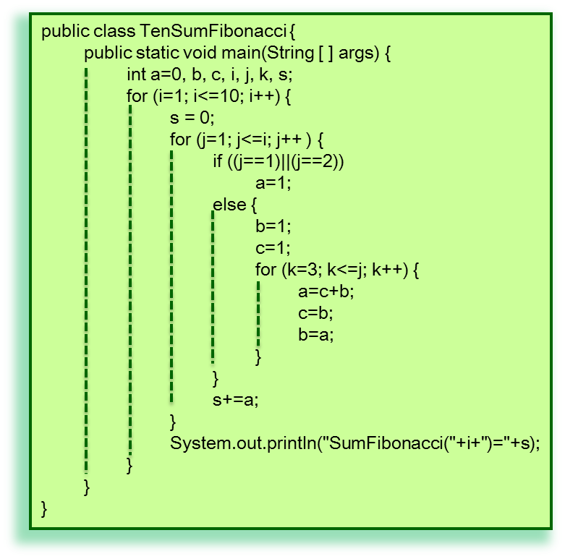
Indentation
Many indentation styles that you could adopt, the general ideas are:
Consistently throughout the program
Code within a block (e.g. bodies of a if, loop, or method) should be indented
For nested blocks, the inner block's body should be indented relative to the enclosing block

Slide 8
Avoid excessive indentation
public class TenSumFibonacci {
public static void main(String[] args) {
int a=0, b, c, i, j, k, s;
for (i=1; i<=10; i++) {
s = 0;
for (j=1; j<=i; j++ ) {
if ((j==1)||(j==2))
a=1;
else {
b=1;
c=1;
for (k=3; k<=j; k++) {
a=c+b;
c=b;
b=a;
}
}
s+=a;
}
System.out.println(s);
}
}
}
public class TenSumFibonacci {
public static void main(String[] args) {
int a=0, b, c, i, j, k, s;
for (i=1; i<=10; i++) {
s = 0;
for (j=1; j<=i; j++ ) {
if ((j==1)||(j==2))
a=1;
else {
b=1;
c=1;
for (k=3; k<=j; k++) {
a=c+b;
c=b;
b=a;
}
}
s+=a;
}
System.out.println(s);
}
}
}

Slide 9
Meaningful identifiers names
Java identifiers
constant, variable, class, method
Meaningless identifier names reduce the program readability
A good identifier name gives the reader a strong hint as to the identifier's purpose within the program
Modern programming language, e.g. Java, permit identifier names to be quite lengthy

Slide 10
Principles applied to naming
Meaningful but not overboard
E.g. for a variable to holds the number of hours an employee works in a week
hours (a lot of doubt, hours for what?)
hours_worked_in_a_week (decriptive but too long)
hours_per_week (good compromise)
Use underscores '_' or mixed cases to separate improve readability of names
E.g. HoursPerWeek, Hours_Per_Week

Slide 11
Always place a comment with each constant or variable name declaration
float avgExamMark; // average exam marks
Common abbreviations (in a project) are often acceptable in names
E.g. num (number), avg (average), len (length)

Slide 12
Internal Documentation
Comments included within source programs
Block comments should be placed at the head of every method
method name
purpose of the method
a list of all parameters, including direction of information transfer (in, out, both)
Each constant and variable must have a brief comment next to its declaration
purpose of the variable

Slide 13
Internal Documentation
Block comments should be placed before complex section of code
Comments should be written and included in the program as the code is being written
Students tend to get in the habit of writing the code and then tossing in some documentation only if they have time before the deadline!
Over commented is not necessary, e.g.
area = side * side; /* area is calculated by square of side */

Slide 14
Example
public class TenSumFibonacci { public static void main( String[] args ) { int fi = 0, // (i)th term in a Fibonacci series: F(i) fi_Minus_1, // (i-1)th term in a Fibonacci series: F(i-1) fi_Minus_2, // (i-2)th term in a Fibonacci series: F(i-2) sumIndex, // Count the number of sums to be calculated termIndex, // Count the number of terms to be summed i, // Counter for calculating a term sum; // sum of F(1) to F(termIndex) for ( sumIndex = 1; sumIndex <= 10; sumIndex++ ) { sum = 0; for ( termIndex = 1; termIndex <= sumIndex; termIndex++ ) { // calculate individual term: F(i) if ( ( termIndex == 1 ) || ( termIndex == 2 ) ) // calcualte F(1) and F(2) fi = 1; else { // calculate F(i) for i >= 3 fi_Minus_1 = 1; fi_Minus_2 = 1; for ( i = 3; i <= termIndex; i++ ) { fi = fi_Minus_1 + fi_Minus_2; // F(i) = F(i-1) + F(i-2) fi_Minus_2 = fi_Minus_1; // shift F(i-1) to F(i-2) fi_Minus_1 = fi; // shift F(i) to F(i-1) } } sum += fi; // sum F(1) to F(termIndex) } System.out.println( "SumFibonacci(" + sumIndex + ")=" + sum ); } } }

Slide 15
External documentation
Large project are documented in great detail
Descriptions that are maintained separately form the code
You may be asked to fix problems in code that the original programmer had left the company
The documentation may be the only reference material to help you make the necessary modifications

Slide 16
External documentation
General description of the problem
Algorithm of the program
Structure charts of the outline of the program
Usually for a project or a large program
For small size programs in this module
A small amount of external documentation can be included at the top of the program in the form of a large block comment

Slide 17
Adding external documentation
Include the following information at the top of your program
Your name & student ID
Course code/title, module code/title
Description of the problem
Approach used to solve the problem, e.g. algorithm
Program creation and modification history, e.g. date (programmer names)

Slide 18
Example – External Documentation
/*============================================================================= | | Programmer: [Student's Name Here] | Language: Java | To Compile: javac TenSumFibonacci.java | To Run: java TenSumFibonacci | | Module: ITE3101 - Introduction to Programming | Course: xxxxxx - HDip in ... | Created: 10-August-2012 (by Ivan Cheang) | Modified: 16-August-2012 (by Peter Lam) | +----------------------------------------------------------------------------- | | Description: To calculate the first 10 sums of Fibonacci series: | | where | F(1) = 1 | F(2) = 1 | F(3) = F(2) + F(1) | F(4) = F(3) + F(2) | ... | F(i) = F(i-1) + F(i-2) | | and | SumF(1) = F(1) | SumF(2) = F(1) + F(2) | SumF(3) = F(1) + F(2) + F(3) | ... | SumF(i) = F(1) + F(2) + ... + F(i) | | Input: No input is required by this program. | | Output: 10 sums: SumF(1) ... SumF(10). | | Algorithm: The sums are generated by a set of 3 nested for loops. | The outer loop counts from 1 to 10 for SunF(i). The middle loop count | the number of F(i) to be summed. The inner loop calculate individual | F(i). | +===========================================================================*/

Slide 19
Developing Good Prog Style
Take the time to ask yourself:
Are the comments easy to find and to read?
Do they distract from the code excessively?
Are there too many of them to suit you, or too few?
Begin to develop a style of your own
When you see documentation styles that you like, consider adopting them into your own style
When you join a software development shop, you should strictly follow the in-house style

Slide 20
Developing Good Prog Style
Usually, you need not to write the most efficient programs, e.g. fewer operations, statements, etc.
But write good style programs
Never pursue efficiency at the expense of clarity
A slow, correct program is better than a fast, buggy one

Slide 21
Example – Modularized Program
public class TenSumFibonacci { public static void main( String[] args ) { int i; // Count the number of sums to be calculated for ( i = 1; i <= 10; i++ ) System.out.println( "SumFibonacci(" + i + ")=" + sumFibonacci( i ) ); } public static int sumFibonacci( int n ) { int sum = 0, // sum of F(1) to F(n) i; // count the number of terms to be summed for ( i = 1; i <= n; i++ ) sum += fibonacci( i ); return sum; } public static int fibonacci( int n ) { int fi = 0, // (i)th term in a Fibonacci series: F(i) fi_Minus_1, // (i-1)th term in a Fibonacci series: F(i-1) fi_Minus_2, // (i-2)th term in a Fibonacci series: F(i-2) i; // counter for calculating a term if ( ( n == 1 ) || ( n == 2 ) ) // calcualte F(1) and F(2) fi = 1; else { // calculate F(i) for i >= 3 fi_Minus_1 = 1; fi_Minus_2 = 1; for ( i = 3; i <= n; i++ ) { fi = fi_Minus_1 + fi_Minus_2; // F(i) = F(i-1) + F(i-2) fi_Minus_2 = fi_Minus_1; // F(i-1) --> F(i-2) fi_Minus_1 = fi; // F(i) --> F(i-1) } } return fi; } }

Slide 22
Summary of Good Prog Style
Indentation
Blank lines
Meaningful names
Appropriate modularization
Readability is important than efficiency
Write comments as you coding

Slide 23

END.

